Slide 1
President’s Report 17 November 2016

Slide 2
Intercampus Faculty Council (IFC)
IFC is meeting today in Columbia
Tom, Sahra, and Mark are attending

Slide 3
Intercampus Faculty Council (IFC)
Proposed changes to CR&Rs
Diversity and inclusion CR&R revision
Prior senate briefing by Emily Love
Circulated to: AF&S, Personnel, Student Affairs standing committees
Post Tenure Review Policy with CR&R revision
Circulated to: Tenure policy and personnel standing committees
Tom Schuman is the campus IFC representative for PTR review
IFC seeking approval of proposed CR&R changes
Redline and IFC informational white papers distributed
Ultimate goal: seeks approval/endorsement of the UM System campus’ Faculty Senates

Slide 4
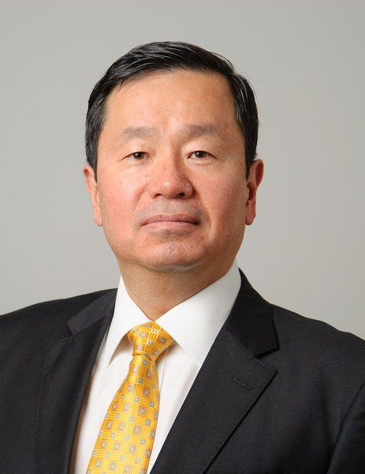
UM System
Mun Y. Choi named new University of Missouri system president
Prior positions:
Provost, UConn 2012, Dean 2008
Dept. Chair, Drexel, 2000
Univ of Illinois, 1993
Ph.D. MAE, 1992, Princeton
Starts UM System 1 March 2017
Visits the S&T campus
29-30 November 2016
Schedule TBA

Slide 5
President Designate Choi to Meet with FRRC Group
Telepresence facilitated by UM System - 22 Nov
Group comprised of FRRC members
Mariesa Crow, Administrator
Merilee Krueger, CASB, Psych
Bih-Ru Lea, CASB, BIT
Doug Bristow, CEC, MAE
Joel Burken, CEC, CArE (chair)
Sahra Sedigh, CEC, ECE
Drs. Middleton and Schuman to also participate

